Slide 1
Guide to make an Instructional Video

Slide 2
Topics
What is an Instructional Video?
Types of Instructional Videos.
Why we use Instructional Videos?
Occur able Mistakes.
Best Suited Software.
Steps to Create Your Own Video.
Determine and Get To Know Your Audience.
Write a Story Board and Script.
Record Your Narration.
Record the Video.
Edit the Video.
Add a Video Intro.
Share your Video.
Pros
Cons
End

Slide 3
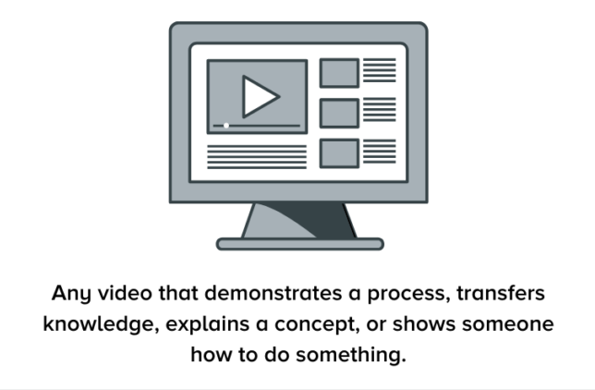
What is an Instructional Video?

Slide 4
Types of Instructional Videos
Microvideos - Short instructional videos that focus on teaching a single, narrow topic.
Tutorial videos - The go-to instructional method for teaching a process or giving step-by-step instructions and are sometimes referred to as “how-to” videos.

Slide 5
Training videos - Designed to improve employees’ workplace skills and often use footage of real people to connect the trainer to the trainee.
Explainer videos - Explain a business concept or product in an entertaining, visual way. They’re usually short and help simplify complex ideas.

Slide 6
Recording a lecture or presentation - These videos tend to be longer than tutorial videos and require a higher level of investment from your audience.
Screencasts - Quick, informal videos composed primarily of screen recordings designed to teach someone to perform a task or share knowledge

Slide 7
Why we use Instructional Videos?
Online shoppers say they use video to help make purchase decisions.
Employees complete tasks better when instructions are provided visually and absorb information 7% faster.
More than 70% of YouTube viewers turn to the platform for help solving problems.

Slide 8
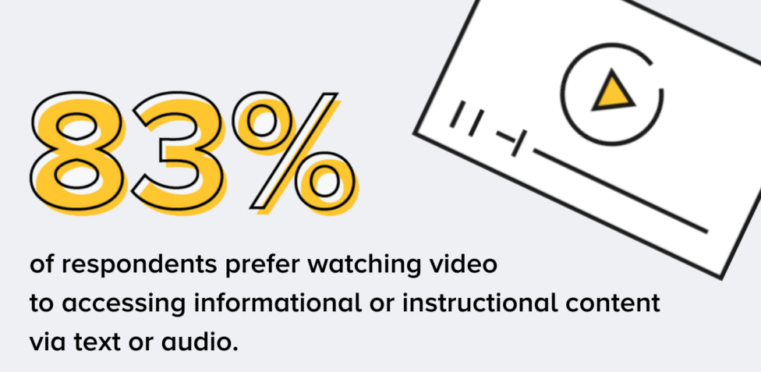

Slide 9

Occur able Mistakes
Mistake #1: Not knowing your audience

Slide 10


Slide 11
Mistake #2: Trying to make your video perfect
People worry about getting their videos perfect. It’s good to remember that perfect is an ‘illusion’.
Do not forget that, the goal of creating an instructional video is to teach someone something, not create a perfect video.

Slide 12
Just Remember That,
Nothing Is Perfect.

Slide 13
Mistake #3: Worrying too much about equipment
It’s easy to get overwhelmed and feel like you don’t have the right tools to create quality videos.
Having the latest and greatest gear is fun, but it’s not a necessity. Learn the basics, then start to upgrade your tools.

Slide 14


Best Suited Software

Slide 15
Steps to create your own video
Step 1: Determine and get to know your audience
Before you even think about hitting the record button, you need to know your target audience and understand why they need help.

Slide 16
If you have a product or service, talk to your customers about how they use your product and where they struggle.
If you’re teaching a class, find out what knowledge or skills your students hope to gain.
Are you training a new hire? Ask yourself what questions they might have and the information they need to succeed.

Slide 17
Then, use that information to choose tutorial topics that will help the most people.
Do Not Skip This Step!

Slide 18
Before you move on to the next step, make sure you can answer these questions:
What is your topic?
Pick only one subject to cover per video, and your instructional video will be more focused and easier to create.

Slide 19
Who is your audience?
Start by determining demographic information, like education, age, professional organizations, etc. and then consider their interests, concerns, and goals.
Why does your audience care about this topic?
If you understand why your audience would watch the video, you can more easily address their concerns.

Slide 20
What is the learning objective of your video?
A clear learning objective helps you provide more straightforward instruction with a more achievable outcome.
How will your video benefit your audience?
What value will they take away if someone invests their time in watching your video?

Slide 21
Step 2: Write a Story Board and Script
Once you have a topic and know your audience, create a storyboard to outline and visualize what you plan to show.
Creating a storyboard ahead of time will help you make an instructional video that is clear, concise, and interesting to your audience.

Slide 22
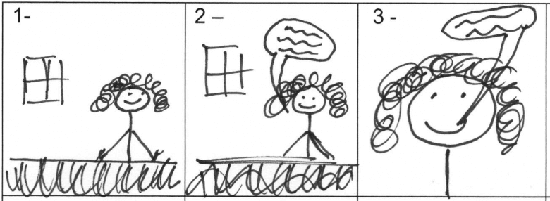
Your storyboard can be as simple as this:

Slide 23
Quick sketches and stick figures are perfectly fine for live video.
If you’ll be recording your screen to demonstrate a process, use a series of simple screenshots to show what you plan to display with the narration.
After storyboarding is done, it’s time to write a script.

Slide 24
Even a simple script will help you be more efficient, saving both yourself and your viewers time. Plus, you’ll also be far less likely to forget something.
It’s helpful to match your narration to what will be happening on screen during your video.

Slide 25
Tips for Script Writing.
Avoid jargon. Using simple language as if you’re explaining the process to a friend will help make your script easier to follow.
Show AND tell. Instead of simply giving a play-by-play of your onscreen actions, take time to explain both what you’re doing and why you’re doing it.
Practice, practice, and then practice some more. Read your script aloud before you record. If you get tripped up, go back and make sure you’re using natural language.

Slide 26
Step 3: Record Your Narration
With your script in hand, it’s time to record the narration.
Camtasia comes with a built-in, easy-to-use voice recording feature that is a great option.
Still, you can take your voiceover and narration recording to the next level with TechSmithAuditate.

Slide 27
Then, find a quiet place to record.
When you’re ready to hit record, make sure you speak slowly and clearly. If you make a mistake, don’t start over.
Pause, then start again right before you made the mistake. You can remove any mistakes when you’re finished recording.

Slide 28
Step 4: Record Your Video
Depending on your instructional video’s topic, you might need to capture a recording of a process happening on your screen, demonstrate something in real life, or both.

Slide 29
Recording your screen for an instructional video.
First, clean up your computer screen and close any unnecessary applications. Turn off notifications that might pop up before you start recording. Follow these directions to get a crisp, clear screen video.
Then, open the application you want to record and conduct a few practice walkthroughs of exactly what you want to show your viewers.

Slide 30
TIP: When you choose a screen capture or screencasting software, pick a tool with built-in recording, editing, and sharing features. It will save you time and let you do all of your work in one tool.
If you want a simple way to increase engagement and help viewers connect with your content, try adding a webcam recording to your screencast.

Slide 31
Recording an instructional video with a camera.
Don’t get overwhelmed by equipment.
Make sure your recording space is well-lit. You’ll either want to record in an area with a lot of natural light or add some video lighting to your equipment list.
Place your camera on a tripod, and position it as close to your subject as possible while still getting everything you need in the shot. Being close to the subject will help you get the best possible audio when recording with a smartphone camera.

Slide 32
Step 5: Edit the Video
Most people feel like they need to be a professional video editor to make a nice-looking video, but the truth is that you don’t need expensive editing tools or a lot of knowledge to get started.

Slide 33
Here are some simple video editing tips to improve your instructional videos by Camtasia:
If you need more time explaining a concept, split the clip and use extend frame to freeze the video.
To speed up a boring part of your recording, add clip speed, then drag the handles to speed it up.

Slide 34
Add interactive elements like callouts, arrows, shapes, lower thirds, or sketch motions to highlight key points in your video.
Adding music to your video isn’t required, but can take a good video to the next level. Choose something upbeat. You want your viewers to feel good as they’re learning.

Slide 35
Step 6: Add a Video Intro
Use a video intro to lead viewers into your content, but don’t get too crazy. Keep your opening simple and to the point.
Viewers want to get to the substance of your video. They don’t care about anything other than what you promised to teach them.
A good intro clearly lays out the topic and quickly explains what viewers can expect to learn.

Slide 36

A good intro clearly lays out the topic and quickly explains what viewers can expect to learn.

Slide 37
Step 7: Share Your Video
Finally, think about where your video will live. There are many video hosting options to choose from these days.
You can share your video directly to online video platforms like YouTube, Vimeo, or Screencast in Camtasia or save the video as a local file to upload on social media.

Slide 38
Before sending your video out into the world, share it with a few people to get some video feedback. This input helps ensure your message is clear, and that your video accomplishes your goals.

Slide 39
Pros
You have complete creative freedom and more control over the budget.

Slide 40
Cons
You can be limited by your skills, time, and resources when going the DIY route.

Slide 41
END

